Slide 1

MCC Technical Writing 2023
Melinda Hobausz

Slide 2



Philosophy
Technical Writing
If I need to use it to create a product, I will learn it.
z

Slide 3
Technical Writing vs. Textbook Publishing
Similarities
Differences
Manuals to Instruct
Different Formats
Some Common Tools
Need to Address Audiences
Documentation
Degree of Data Manipulation
Number of Audiences
Level of Automation
Focus on Content
Design and Graphics

Slide 4
What Did I Learn?
Writer/Teacher compared to Technical Writer
Why are programs important?
What is missed by focusing on programs?

Slide 5
What Didn’t Do It For Me and Why
z
FrameMaker
Madcap Flare
Github

Slide 6

FrameMaker
Old, but still in use
Only available on PCs
Does do conditional text
Clunky and not particularly user friendly
Not as good for design as InDesign

Slide 7
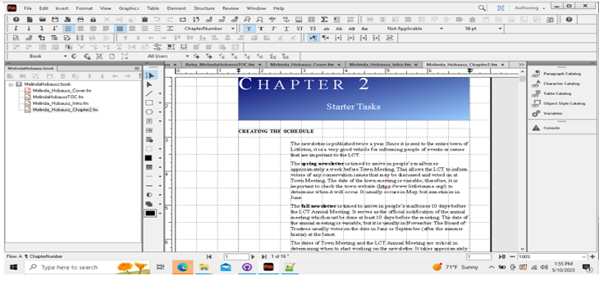
Interface is complex.
Book and file arrangement makes sense; but seems confusing when working across documents.
Master pages are not as easily produced as in InDesign.
Style sheets are understandable and easily applied.
$40 dollars a month
FRAMEMAKER

Slide 8

MadCap Flare
Disappointed!
Veneer of Ease
Allows Collaboration
Content Can Be Imported
Does Make Automation Easier

Slide 9

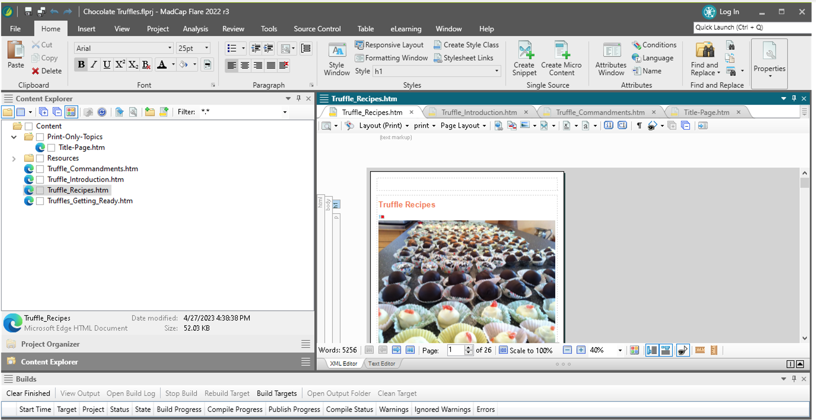
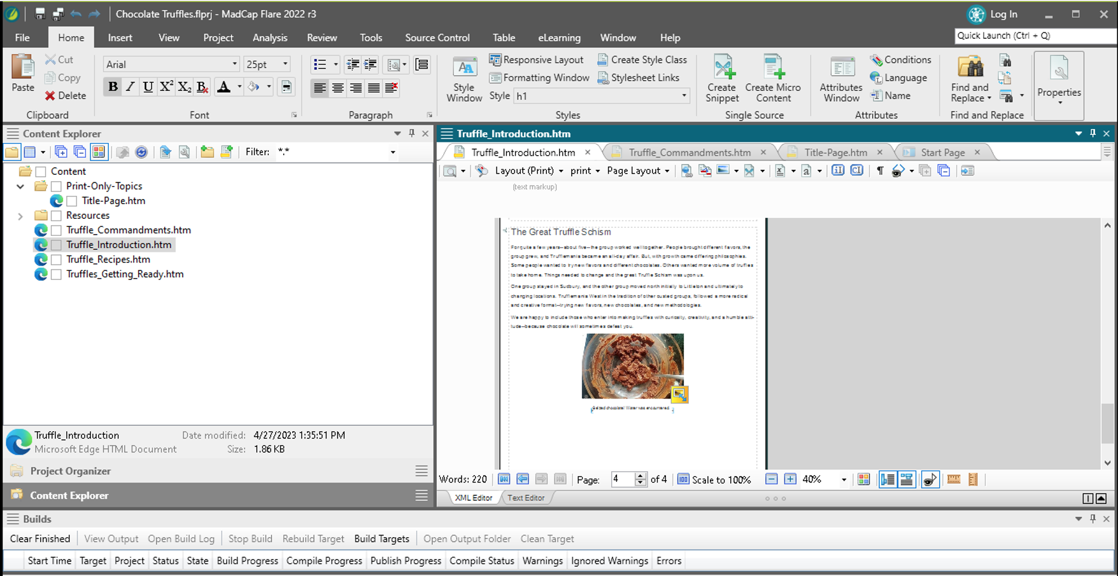
Only for PCs.
Conditional Text Easy to Create and Apply
Not Intuitive or Drag and Drop
Build Feature Not Obvious
Content Seems Secondary to Organization
Most Likely to Continue Playing With This Program
Expensive--$182 per month!
z
MADCAP
FLARE

Slide 10

GitHub
Too Easy to Go Astray
Not Worth the Free

Slide 11
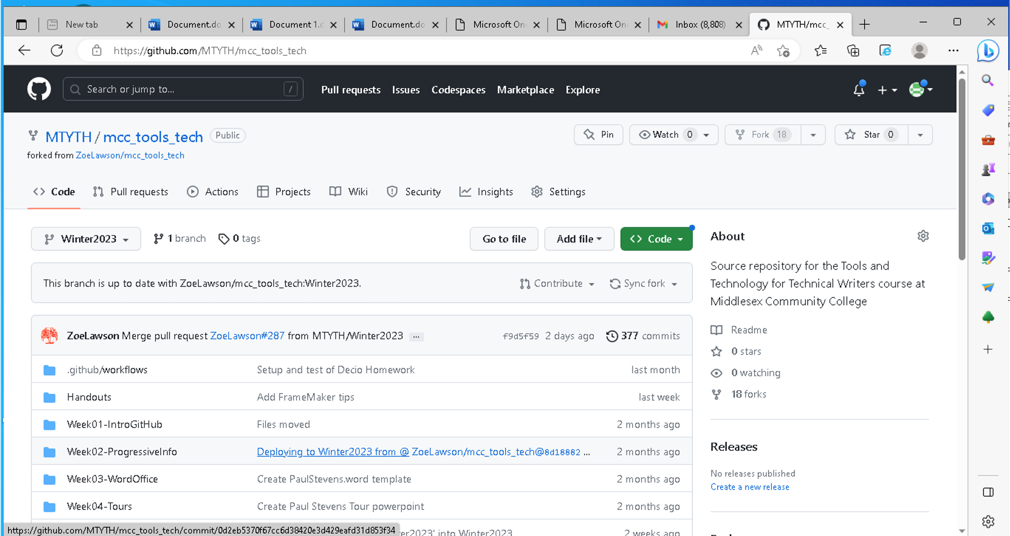
It is too easy to make a mistake. Not efficient.
Not easy to call up earlier versions.
Source can be overwritten if not careful—and, yes, recovered in most cases.
Other options are available, but at a cost.
Free is not always better.
GITHUB

Slide 12
What Did Do It For Me and Why
z
Oxygen
InDesign

Slide 13

Oxygen
Versatile
Achieves the Purpose

Slide 14
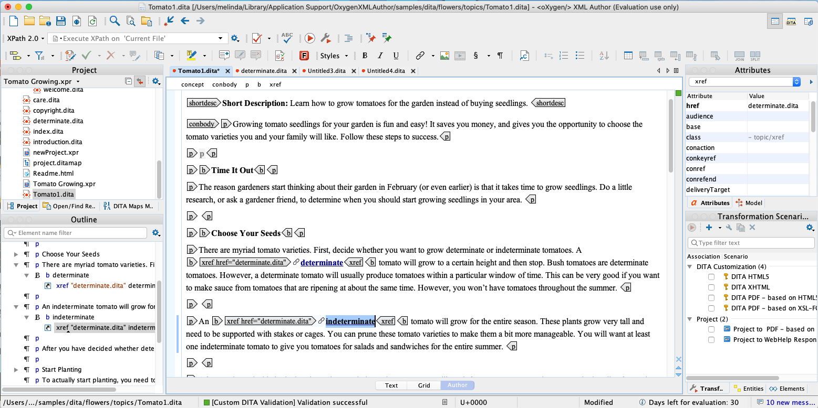
Organizes DITA resources in projects.
User can create templates.
More user friendly—terminology common.
Explicit about coding--if desired.
Easy creation of cross references.
Style guides and frameworks.
PC and Mac capable.
Not that expensive--$240
O
X
Y
G
E
N
X
M
L
If you are interested, this is one of a series that seemed quite good. https://www.youtube.com/watch?v=rs04iX_RdIk

Slide 15

InDesign
Powerful for Print and Online Applications
Supports Conditional Formatting

Slide 16
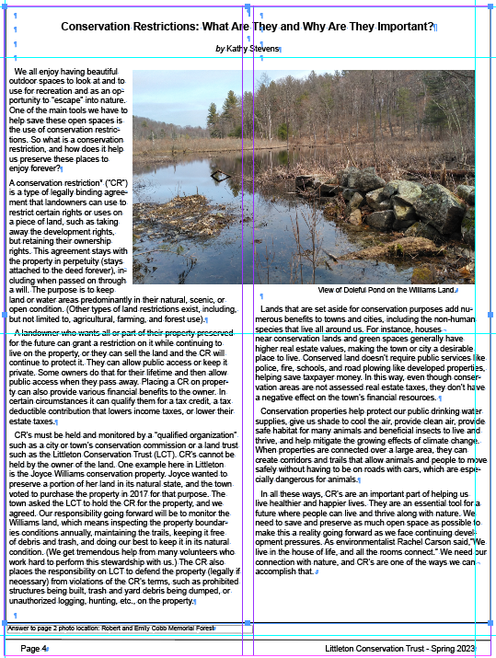
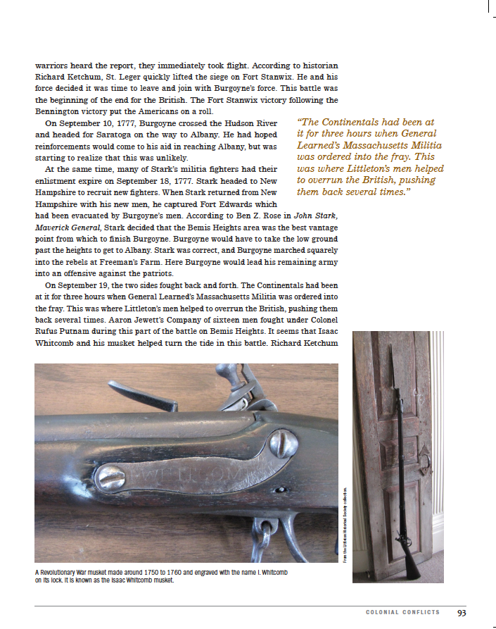
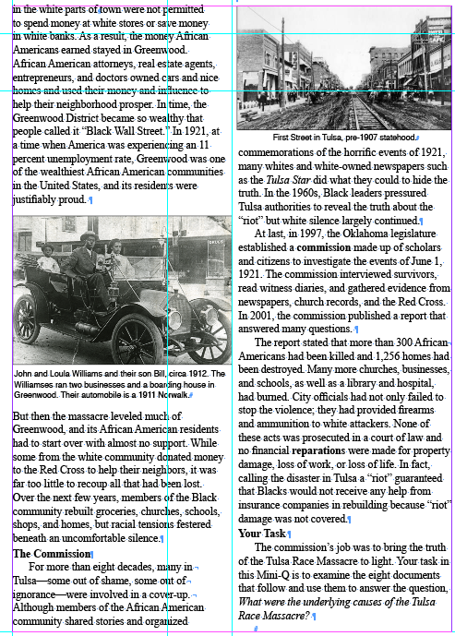
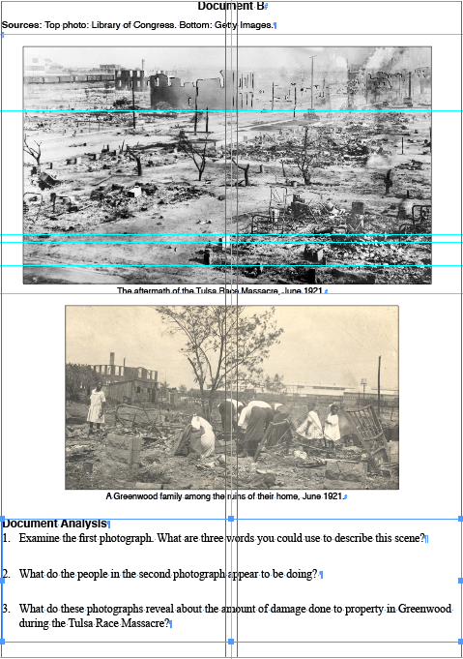
For PCs and Macs.
Conditional Text Possible, and can create sets for automation; layers also possible
Powerful Design Capabilities
May be better suited to smaller companies
Focus is on high-quality and unique content
Not as powerful as FrameMaker for structured content.
Good ability for collaboration through InCopy
Will produce extremely large documents—many textbooks are created in InDesign
Too easy to break links; not as powerful if there are many moving components
Budget Friendly; $240 a year.
z
I
N
D
E
S
I
G
N

Slide 17
Conclusions
There are many products/programs available to get materials out to users.
It is the project or the company that dictates which programs are used.
Companies don’t always use programs appropriate to projects due to cost and sometimes lack of will to update.
Technical writing in the modern era is about writing, but less so than I expected. Understanding how to develop structured content is critical.
I don’t like or dislike any program—I just want whatever I use to have the ability to create the product in the most efficient (and easiest) way possible.
All of these programs require time to master, preferably time for which you are paid.
You can break Github, but Zoe can save you. ; - )

